Slide 1
Final Project Presentation
Team: FIT3161_MA_4
Group Members: Jason, Wen Zhong and Ethan

Slide 2
Introduction
Project title
Improving Software Testing
Background
Our main objective is to devise a method which is effective at finding fault proneness of a system module/class with imbalance data.

Slide 3
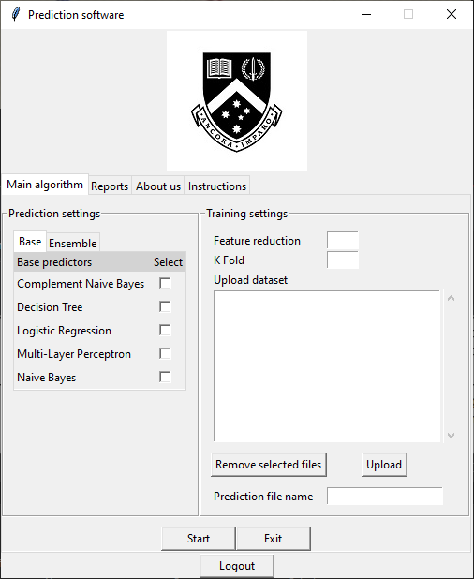
Project Outcome: Fault prediction software
The final product of our project is a software which builds and evaluates the performance of various fault prediction models for any given dataset.
List of prediction models included:
Base:
Decision Tree
Naive Bayes
Complement Naive Bayes
Logistic Regression
Multi-layer Perceptron
Ensemble:
Random Forest
Rotation Forest
Voting

Slide 4
Project Outcome: Fault prediction software
Our software also includes several hidden algorithms which help to boost the performance of the prediction models.
List of algorithms included:
Instance Hardness Threshold (IHT) undersampling algorithm to deal with imbalanced data
Feature selection algorithms for selecting the best predictive features:
Correlation-based feature selection (CFS)
Recursive Feature Elimination (RFE)
Data preprocessing algorithm which handles missing data and outliers within the dataset
K-fold cross validation algorithm to help with training and testing the prediction models.

Slide 5
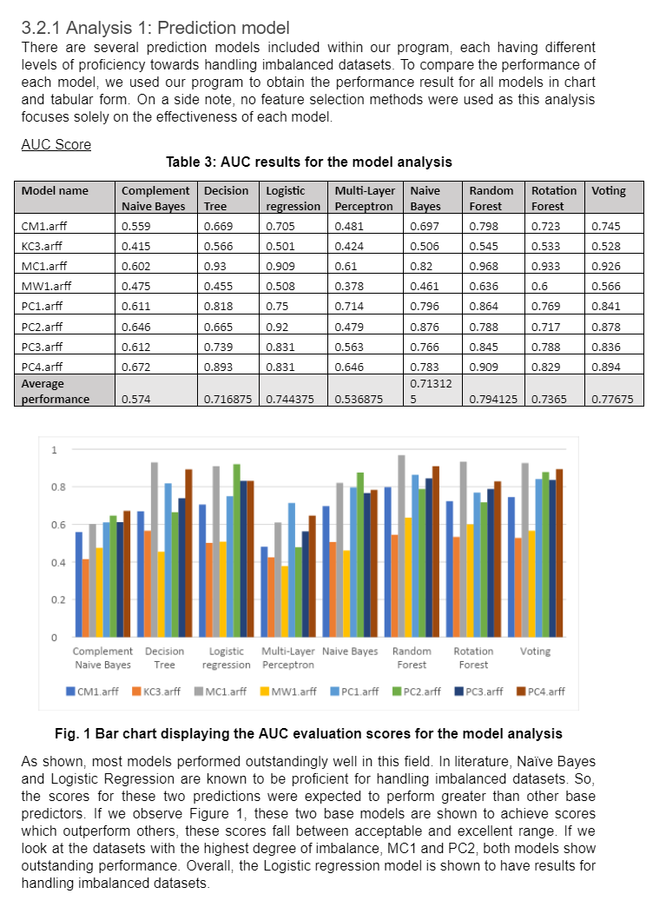
Project Outcome: Analysis of results
Through the usage of our application, we were able to conduct a number of experiments to examine the performances of various combinations of models and techniques. For this, we used datasets from the NASA and PROMISE repository, and our analysis includes:
Analysis 1: Prediction model
Analysis 2: Feature reduction
Analysis 3: Feature selection method
Analysis 4: Performance comparison with other algorithms from other research papers
Analysis 4 is a comparative analysis, where we compare our method with other algorithm from other research papers.

Slide 6
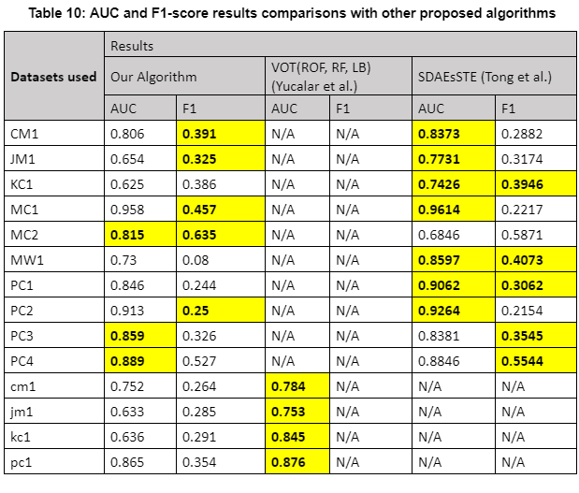
Project Outcome: Comparison with other algorithms
For the 4th analysis, we used our best performing prediction model (Voting) to do a performance comparison with other algorithms from other research papers. The two algorithms included from the research papers are as follows:
A voting ensemble method implemented by Yucalar et al. (2020)
Tong et al. (2018) proposed approach, SDAEsSTE
Below are our findings:
Our algorithm excels in the F1-score evaluation metric
We have decent performance on the AUC evaluation metric, but hardly outperform other algorithms in that evaluation metric

Slide 7
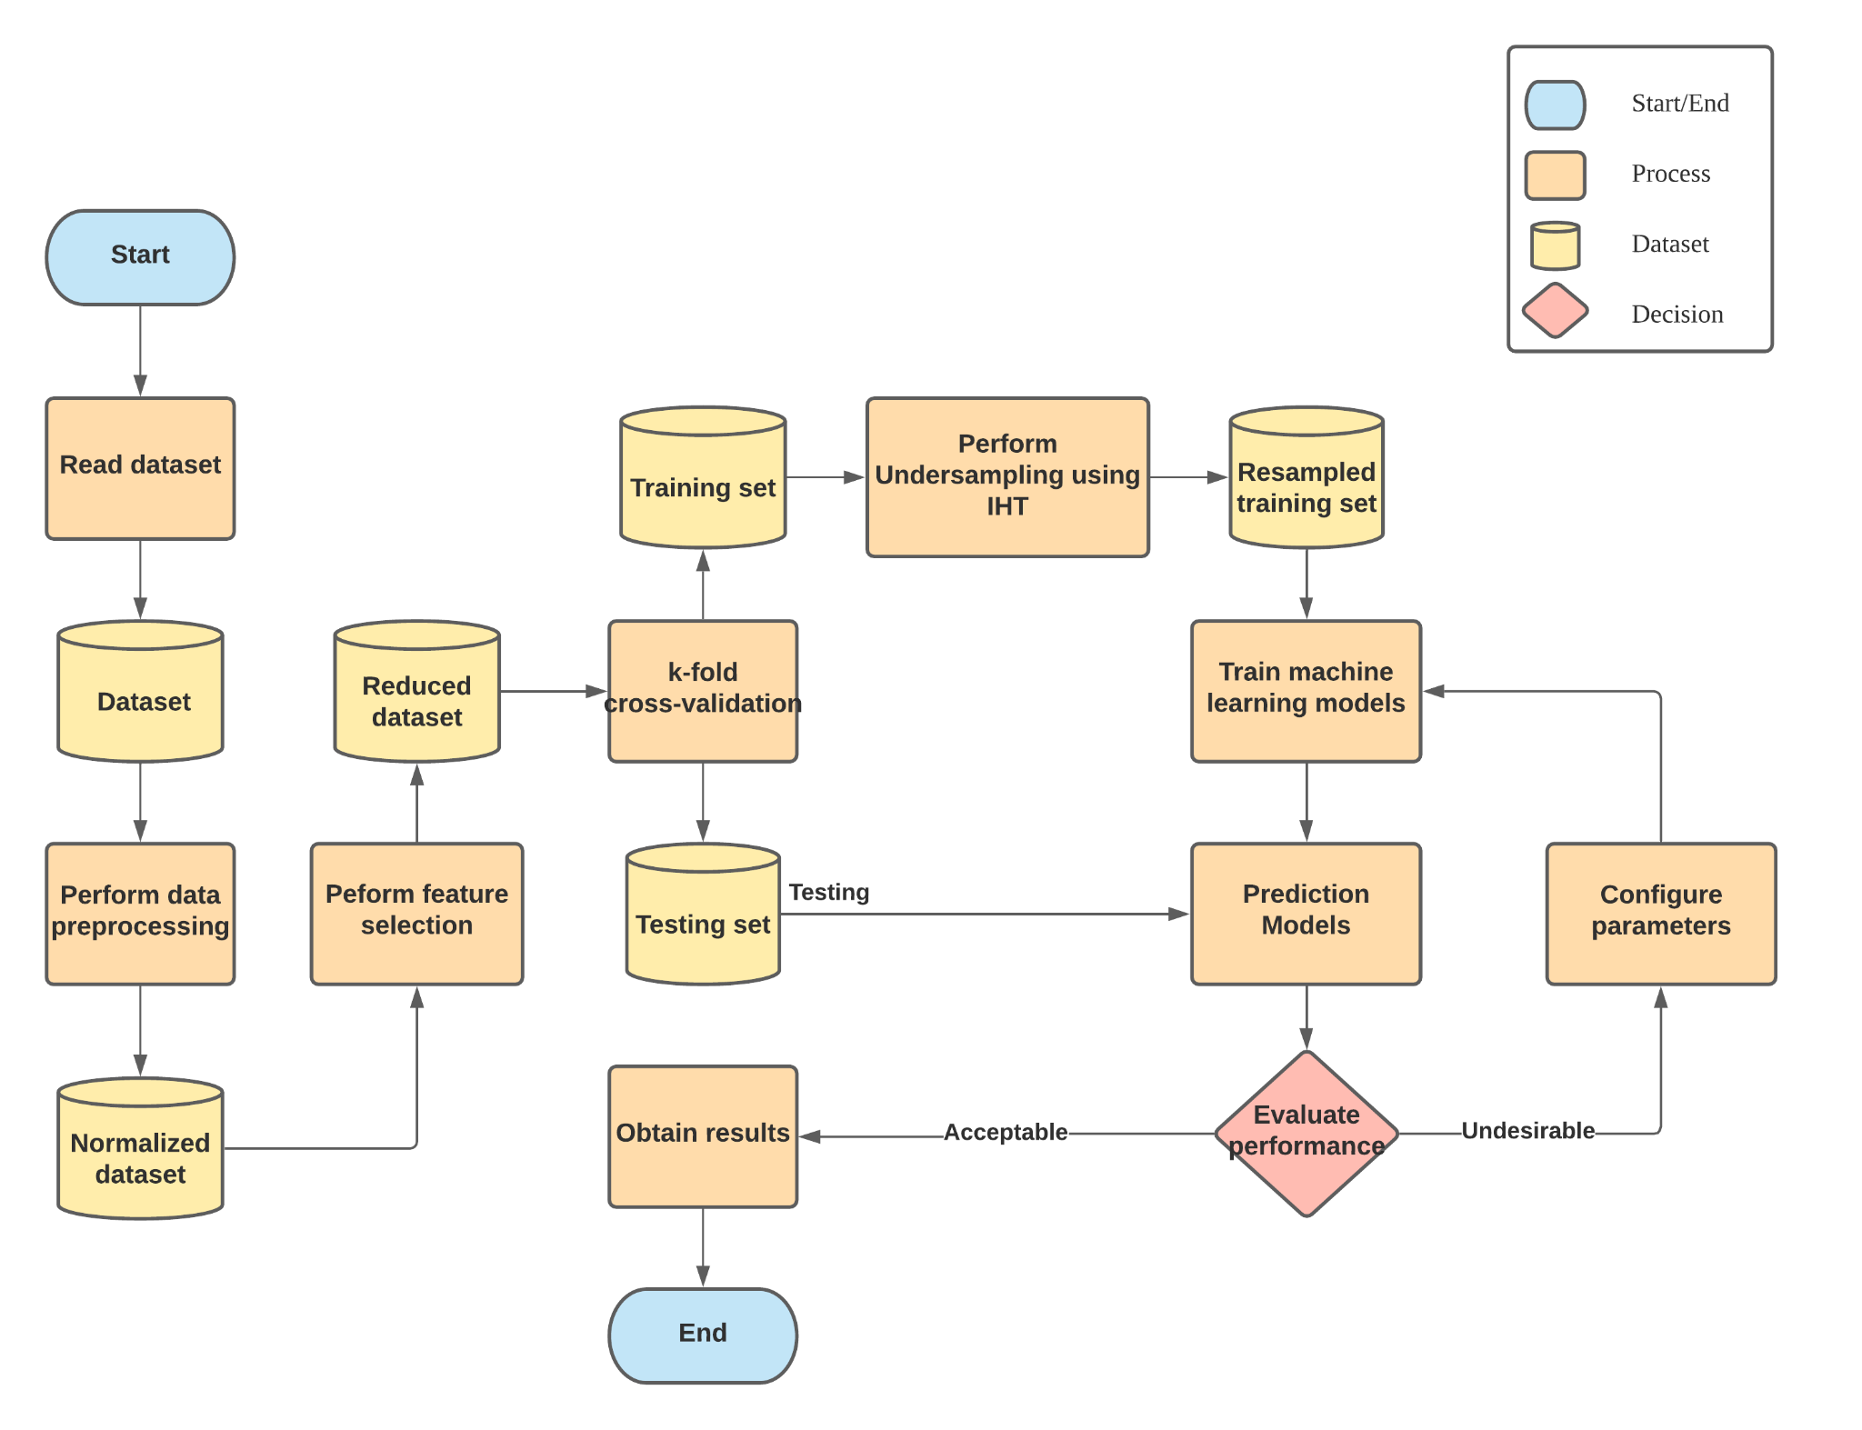
Methodology used: System architecture
The flowchart shows a graphical representation of our system’s flow.
Our system consist of 3 main components:
Data preparation
Data extraction and processing
Retrieving training test splits
Main algorithm
Performed after data preparation
Building models and evaluating their performances
User interface
Graphical user interface to provide a better means of interaction the user and our system

Slide 8
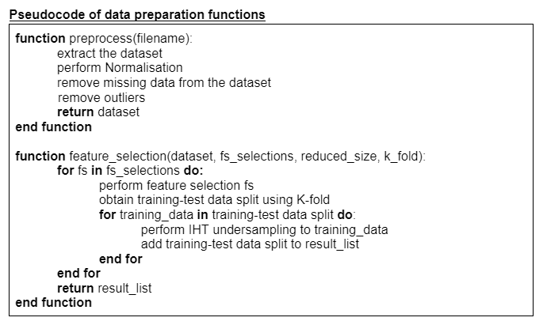
Methodology used: Data preparation
preprocess():
Function which extracts the data from the given file, perform preprocessing on its content before being passed to the next function.
feature_selection():
Function used to generate multiple sets of training-test splits to be used to evaluate the models. The number of sets are based on the number of feature selection methods the user chooses. One thing to highlight is that the result contains the training-test splits of all versions of the datasets for each feature selection method.

Slide 9
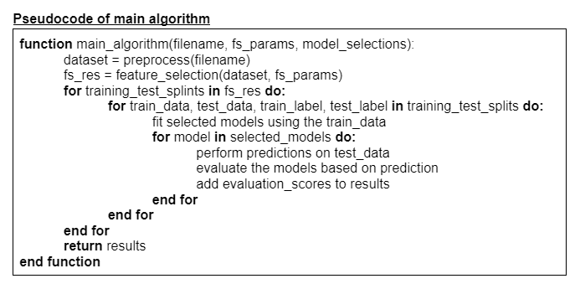
Methodology used: Main algorithm
main_algorithm():
The main algorithm utilizes the two functions for data preparation to perform the required computations on the dataset given, and produce the sets of training/test splits. The last parameter is used to determine the models to build. The results returned is an array of evaluation scores, ordered based on the dataset and feature selection used indicated in the first column. The result will also be used to produce the csv output file.

Slide 10
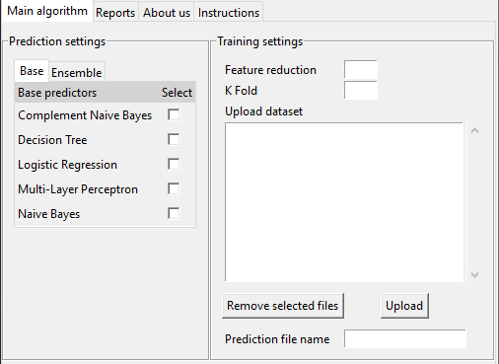
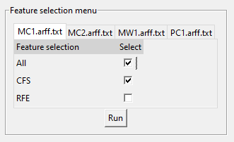
Methodology used: User interface
Provides the user with an outlet to interact with the functionalities of the main algorithm. Below are a few things which the user can do with our user interface:
Selection of prediction models
Upload their own datasets
Configuration of training settings for the models
Configuration of feature selection algorithms to be used by the main algorithm

Slide 11
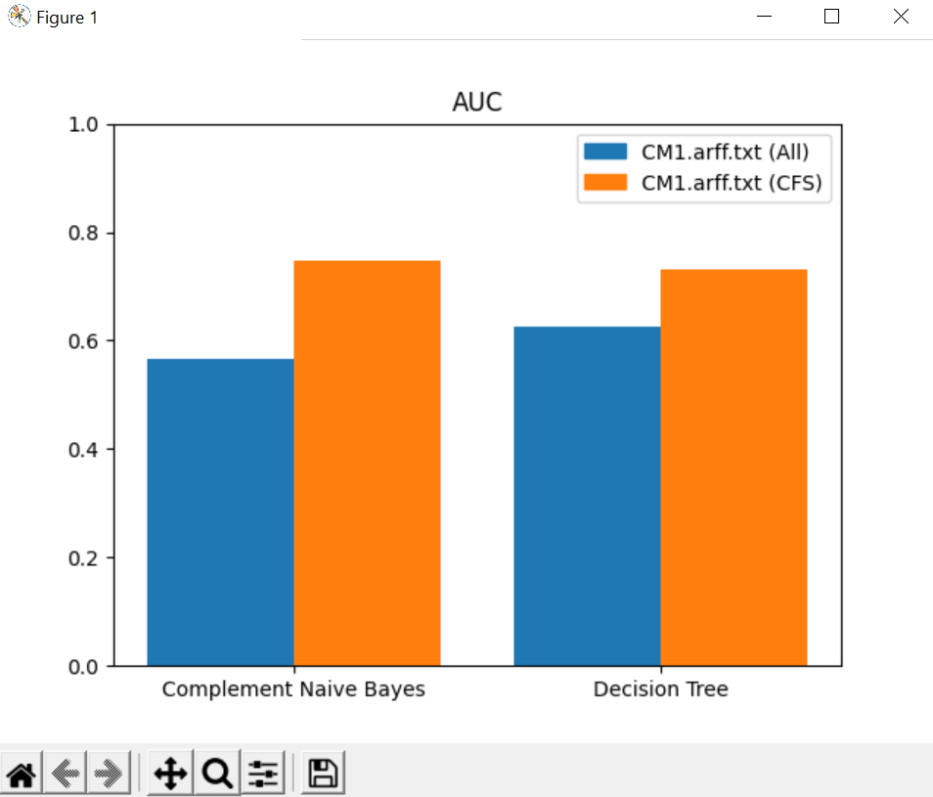
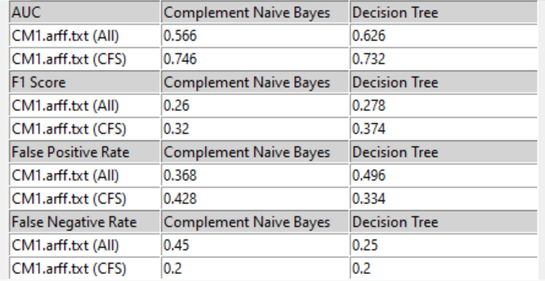
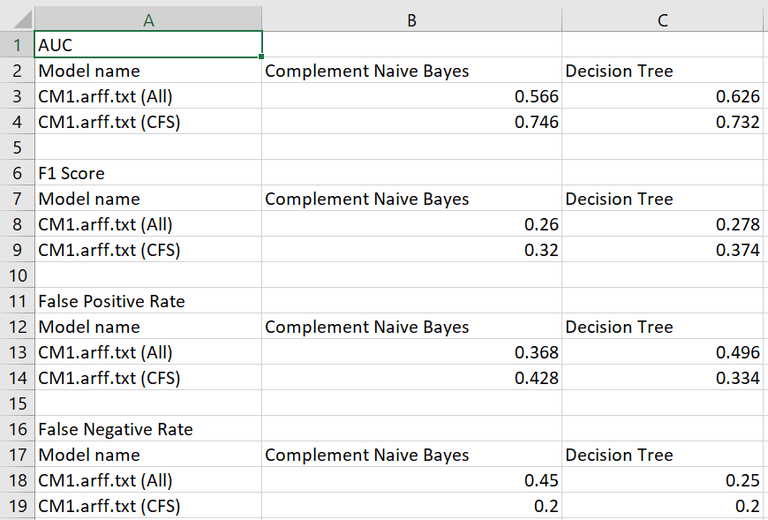
Methodology used: User interface
After computation, the program will display the results in both a tabulated form and a chart form through the user interface. Additionally, these results are saved and stored inside the csv_results folder in the form of a .csv file.
Result display samples:
Table View (Left)
Chart View (Right)
CSV Form (Bottom)

Slide 12
Software deliverables
What are we delivering?
A GUI application that predicts the fault-proneness of any software modules
This software application should deal with the issue of data imbalance
Built entirely in Python using tkinter and sklearn
Runs by clicking on the executable file

Slide 13
Project Management and methodology
Project Management methodology used: Agile
Iterative and incremental nature, which allows the project to be open to changing requirements
Allows team to incorporate any modifications towards the project
Final product will be of high quality

Slide 14
Discussion and possible further work
Current program
Only accepts dataset as input
External packages are required to install
Exposed to only two types of metrics
Static code metric and object oriented metric
Future Work
Automate the process of extracting the metrics
Web and mobile version of the application
Inclusion of other software metrics
E.g. functional and component-based metric

Slide 15
Thank you!

